Slide 1
CONTROL UNIT

Slide 2
The Control Unit was historically defined as one distinct part of the 1946
reference model of Von Neumann architecture.
The function of control unit is to generate relevant timing and control signals to all operations in the computer.
Control Unit is “the brain within the brain”.
It controls the flow of data between the processor and memory and peripherals.
The examples of devices that require a control unit are CPUs and graphics processing units (GPUs).

Slide 3
FUNCTIONS
The control unit directs the entire computer system to carry out stored
program instructions.
The control unit must communicate with both the arithmetic logic unit (ALU) and main memory.
The control unit instructs the arithmetic logic unit that which logical or
arithmetic operation is to be performed.
The control unit co-ordinates the activities of the other two units as well as all peripherals and auxiliary storage devices linked to the computer.

Slide 4
TYPES
Control unit generates control signals using one of the two
organizations :
Hardwired Control Unit.
Micro-programmed Control Unit.

Slide 5
Hardwired Control Unit
Hardwired control units are implemented through use of sequential
logic units or circuits like gates , fliflops , decoders in hardware.
Hardwired control units are generally faster than micro-programmed designs.
This architecture is preferred in reduced instruction set computers (RISC)
as they use a simpler instruction set.
The hardwired approach has become less popular as computers have evolved as at one time, control units for CPUs were ad-hoc logic, and they were difficult to design.

Slide 6
ADVANTAGES
Hardwired Control Unit is fast because control signals are generated by
combinational circuits.
The delay in generation of control signals depends upon the number of gates.
The performances is high as compared to micro-programmed control unit.

Slide 7
DISADVANTAGES
The control signals required by the CPU will be more complex
Modifications in control signal are very difficult. That means it requires rearranging of wires in the hardware circuit.
It is difficult to correct mistake in original design or adding new features
in existing design of control unit.

Slide 8
CONSIST OF:
Control unit consist of a:
Instruction Register
Number of Control Logic Gates,
Two Decoders
4-bit Sequence Counter

Slide 9
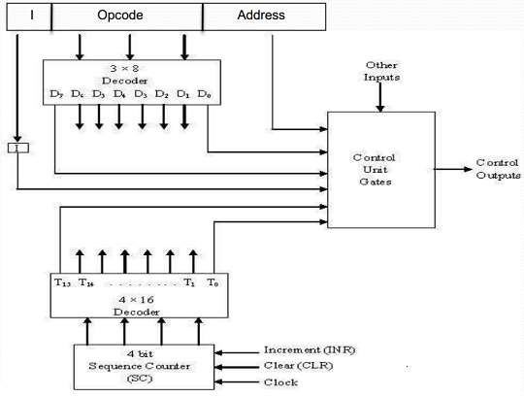
ARCHITECTURE

Slide 10
An instruction read from memory is placed in the instruction register (IR).
The instruction register is divided into three parts: the I bit, operation code, and address part.
First 12-bits (0-11) to specify an address, next 3-bits specify the operation code (opcode) field of the instruction and last left most bit specify the addressing mode I.
I = 0 for direct address
I = 1 for indirect address

Slide 11
First 12-bits (0-11) are applied to the control logic gates.
The operation code bits (12 – 14) are decoded with a 3 x 8 decoder.
The eight outputs ( D0 through D7) from a decoder goes to the control logic gates to perform specific operation.
Last bit 15 is transferred to a I flip-flop designated by symbol I.

Slide 12
The 4-bit sequence counter SC can count in binary from 0 through 15.
The counter output is decoded into 16 timing pulses T0 through T15.
The sequence counter can be incremented by INR.
input or clear by CLR input synchronously.

Slide 13
EXAMPLE
Consider the case where SC is incremented to provide timing signalsT0, T1, T 2 , T3, and T4 in sequence. At time T4 , SC is cleared to 0 if decoder output D3 is active. This is expressed symbolically by the statement:
D3 T4 : SC ← 0
The timing diagram shows the time relationship of the control signals.

Slide 14
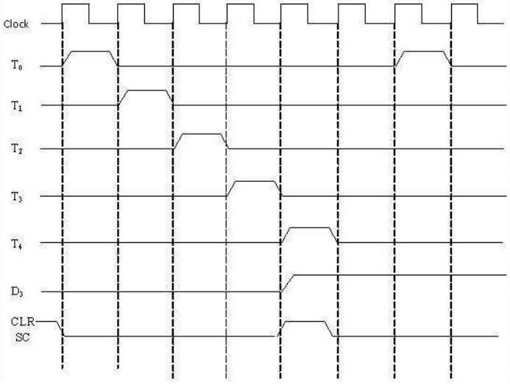
TIMING DIAGRAM

Slide 15
MICRO-PROGRAMMED CONTROL UNIT
The idea of microprogramming was introduced by Maurice Wilkes in 1951.
Micro-programs were organized as a sequence of microinstructions and stored in special control memory.
The main advantage of the micro-program control unit is the simplicity of its structure.
Outputs of the controller are organized in microinstructions and they can be easily replaced

Slide 16
A micro-programmed control unit is implemented using programming approach. A sequence of micro operations are carried out by executing a program consisting of micro-instructions.
Micro-program, consisting of micro-instructions is stored in the control memory of the control unit.
Execution of a micro-instruction is responsible for generation of a set of control signals.

Slide 17
Micro-Programs: Microprogramming is the concept for generating control signals using programs. These programs are called micro - programs.
Micro-Instructions: The instructions that make micro-program are called micro-instructions.
Micro-Code: Micro-program is a group of microinstructions. The micro- program can also be termed as micro-code.
Control Memory: Micro-programs are stored in the read only memory (ROM). That memory is called control memory.

Slide 18
ADVANTAGES
The design of micro-program control unit is less complex because micro-
programs are implemented using software routines.
The micro-programmed control unit is more flexible because design modifications, correction and enhancement is easily possible.
The new or modified instruction set of CPU can be easily implemented by
simply rewriting or modifying the contents of control memory.
The fault can be easily diagnosed in the micro-program control unit using diagnostics tools by maintaining the contents of flags, registers and counters.

Slide 19
DISADVANTAGES
The micro-program control unit is slower than hardwired control unit.
That means to execute an instruction in micro-program control unit requires more time.
The micro-program control unit is expensive than hardwired control unit
in case of limited hardware resources.
The design duration of micro-program control unit is more than hardwired control unit for smaller CPU.

Slide 20
CONSIST OF :
Control unit consist of a :
Next address generator
Control address register
Control memory
Control data register

Slide 21
ARCHITECTURE
The address of micro-instruction that is to be executed is stored in the
control address register (CAR).
Micro-instruction corresponding to the address stored in CAR is fetched from control memory and is stored in the control data register (CDR).
This micro-instruction contains control word to execute one or more
micro-operations.
After the execution of all micro-operations of micro-instruction, the address of next micro-instruction is located.

Slide 22
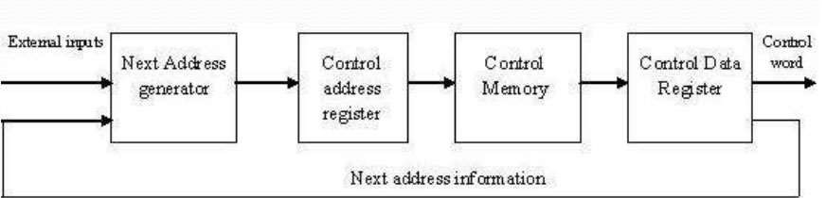

Slide 23
COMPARISON BETWEEN HARDWIRED AND MICROPRGRAMMED
CONTROL UNIT
ATTRIBUTE | HARDWIRED CONTROL UNIT | MICRO-PROGRAMMED CONTROL UNIT
SPEED | FAST | SLOW
COST OF IMPLEMENTATION | MORE | CHEAPER
FLEXIBILITY | NOT FLEXIBLE, DIFFICULT TO MODIFY FOR NEW INSTRUCTION | FLEXIBLE, NEW INSTRUCTIONS CAN BE ADDED
ABILITY TO HANDLE COMPLEX INSTRUCTION | DIFFICULT | EASIER
DECODING | COMPLEX | EASY
APPLICATION | RISC MICROPROCESSOR | CISC MICROPROCESSOR
INSTRUCTION SET SIZE | SMALL | LARGE
CONTROL MEMORY | ABSENT | PRESENT
CHIP AREA REQUIRED | LESS | MORE 23

Slide 24
THANKYOU
COMPUTER ORGANIZATION AND ARCHITECTURE
24

